Slide 1
API TESTING
BY Lavanya g

Slide 2
Agenda of API Testing
API and API Testing
Tool Selection
Work Flow
API Methods
Advantages of API Testing
Challenges of API Testing

Slide 3
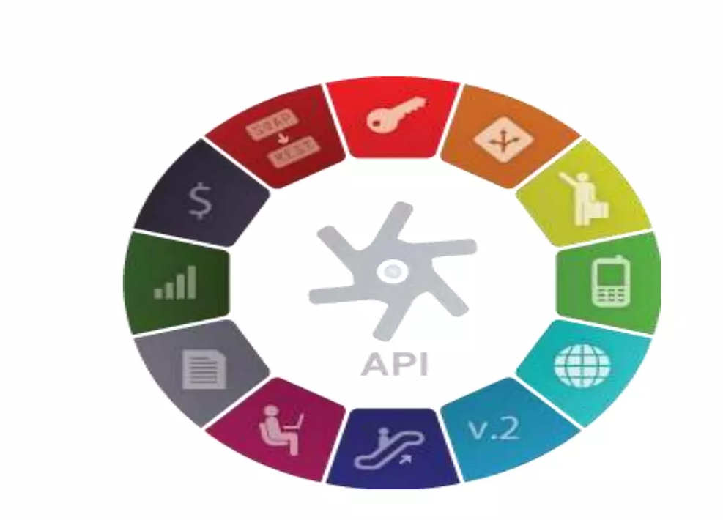
What is API?
API stands for Application Programming
Interface.
API is an software interface,
not a user interface.
Implemented by writing function
calls in the program.

Slide 4

What is API Testing?
API testing uses software to send
calls to the API and get the output.
API testing treats the component
under test as a black box.
The goal of API testing is to verify correct
performance and error handling of the
component prior to its integration into an application.

Slide 5
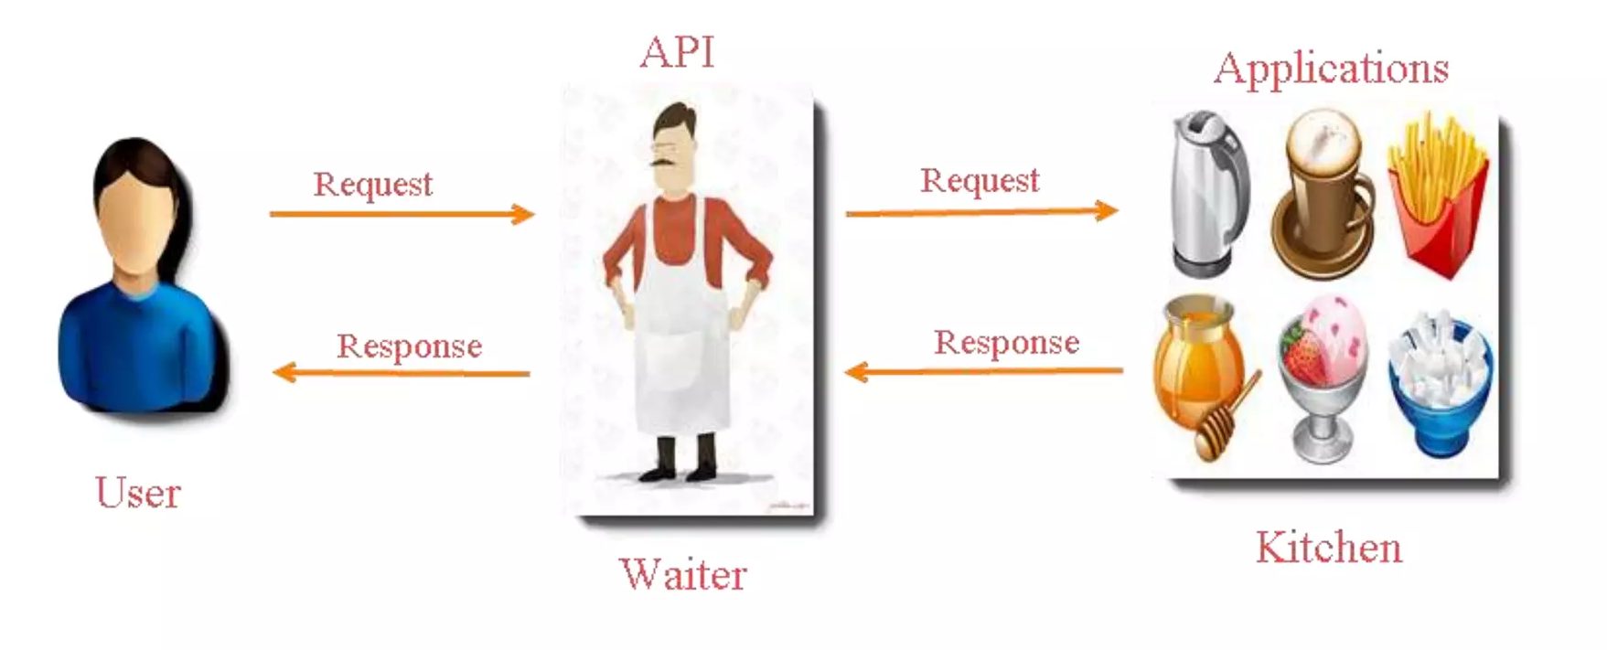
API Workflow

Slide 6
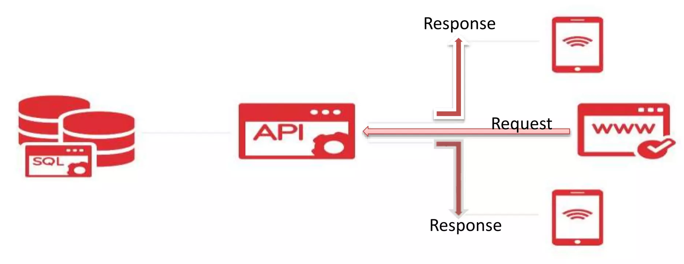
API Workflow

Slide 7

REST API
REST – stands for Representational State Transfer.
It is a set of functions to which the developers performs request and
receive responses. In REST API interaction is made via HTTP protocol.
REST also allows computers to talk to each other over a network.
It involves using HTTP methods to send and receive message, and does not require a strict message definition, unlike Web services.
REST messages often take the form of XML, or JavaScript Object Notation (JSON).

Slide 8
HTTP Methods
4 commonly Used Methods :
GET: Provides a Read only access to a resource.
POST: Used to Update and existing resource or create a new resource.
PUT: Used to Create a new resource.
DELETE: Used to Remove a resource.
RESOUCE | GET | POST | PUT | DELETE
URL | Retrieve the member | Create new entry | Create/Replace new resource | Used to remove resource

Slide 9
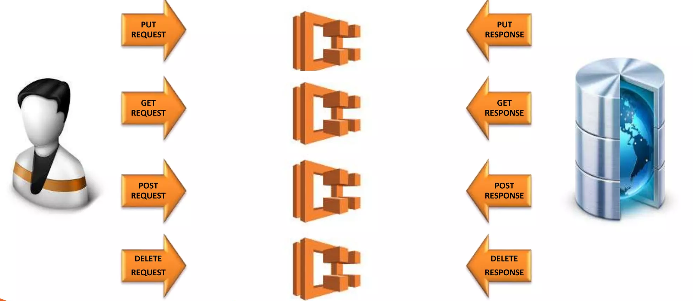
What is API Testing?

Slide 10
REST API Inputs
GET | POST | PUT | DELETE
Method – GET | Method – POST | Method – PUT | Method – DELETE
URL | URL | URL | URL
Custom-Header | Custom-Header | Custom-Header | Custom-Header
 | Input JSON

Slide 11
HTTP Response Codes
Some HTTP response codes, which are often used with REST:
200 OK: Code indicates that the request was successful.
201 Created: Code indicates that request was successful and a resource was created. It is used to confirm success of a PUT or POST request.
400 Bad Request: It happens especially with POST and PUT request, when the data does not pass validation or is in wrong format.
404 Not Found: response indicates that the required resource could not be found.
401 Unauthorized: error indicates that you need to perform authentication before accessing the resource.
405 Method Not Allowed: HTTP method used to supported for this resource.
409 Conflict: Conflict request to create the same resource twice.
500 Internal Server Error: Occurs due to some error on Server side.

Slide 12
Advantages of API Testing
Advantages of API Testing:
Time Effective
Language Independent
Test Core Functionality
Reduce Testing Cost
Reduced Risks

Slide 13
Challenges of API Testing
Challenges of API Testing:
Main challenges in API testing is Parameter Combination, Parameter Selection, and Calls Sequencing.
There is no GUI available to the application which makes difficult to give input values.
Parameter selection and categorization required to be know to the tester.
Exception handling function needs to be tested.

Slide 14
THANK YOU

